Slide 1
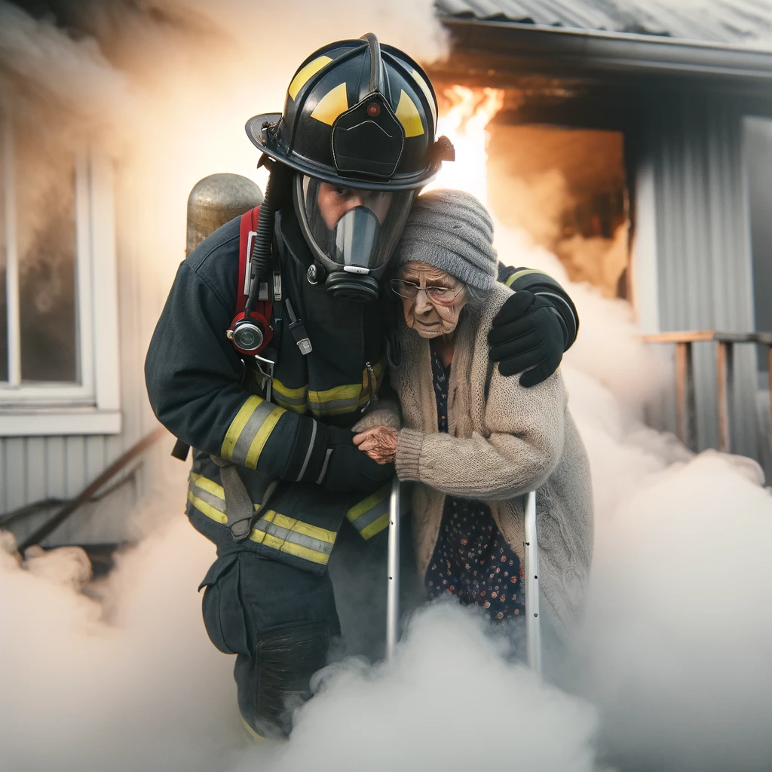
ResqU
Team Ayran BoyZ
A Security Application for the Disabled People

Slide 2
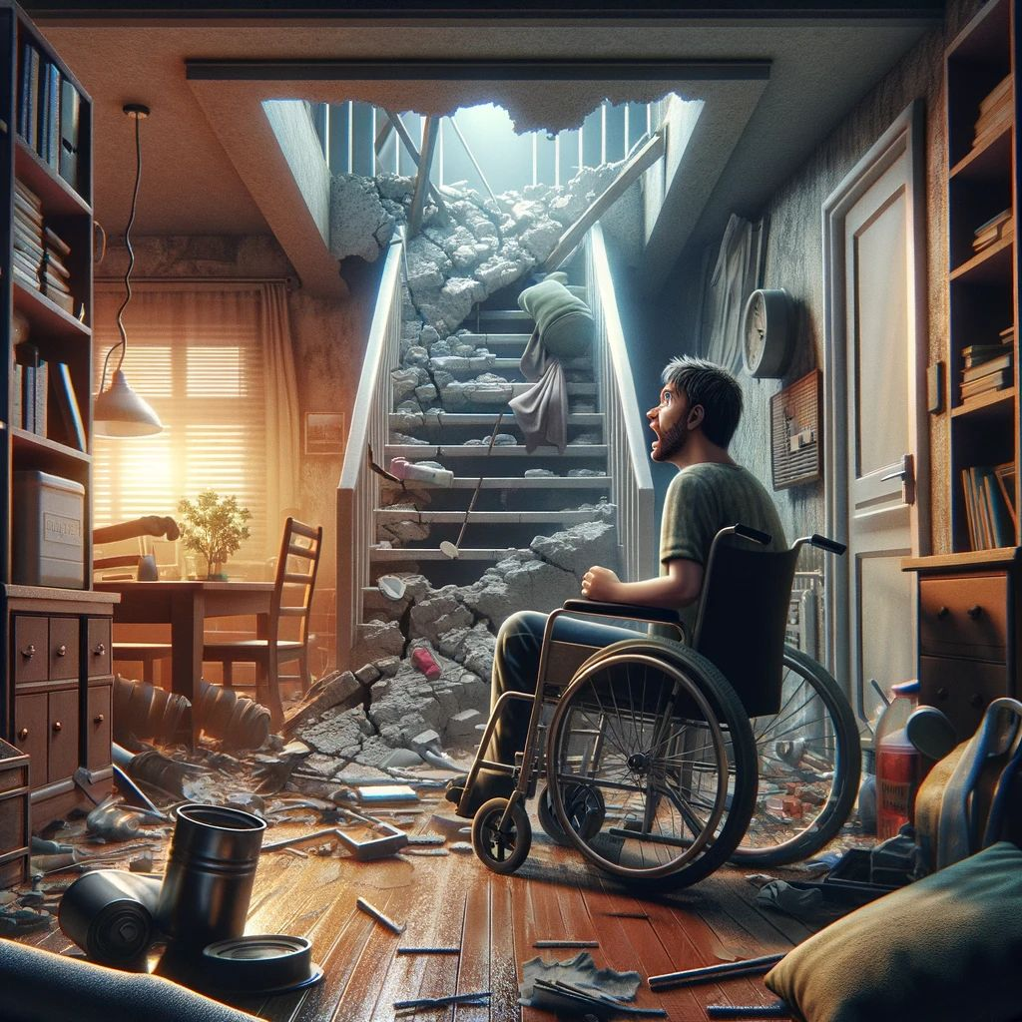
Problem
If any disaster were to occur inside of a building, the disabled people would be the most endangered group. In the midst of the evacuation where “everyone’s for themselves” the people with the disabilities are the most likely to be left out.

Slide 3
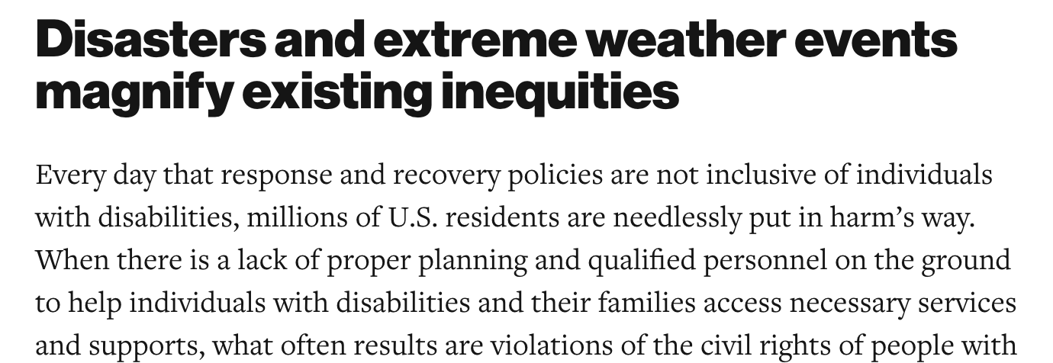
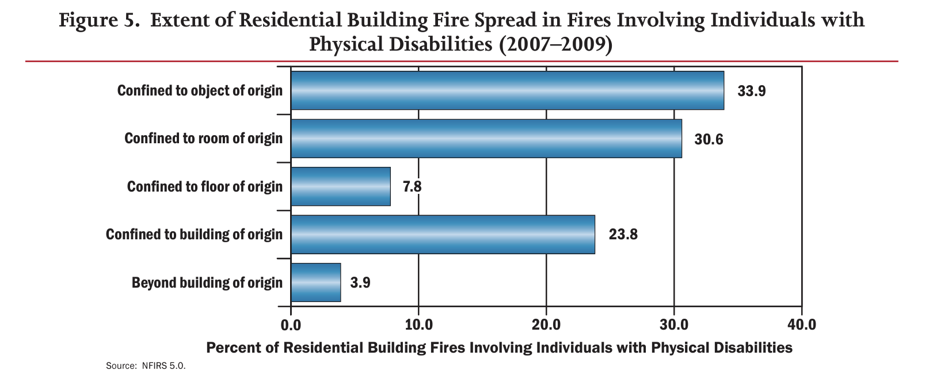
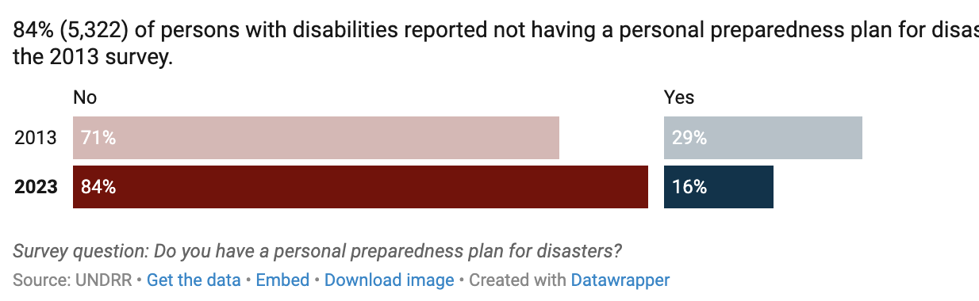
Relevance
The research only further proves that this issue is very relevant in present day society, and the lack of attention to it only increases the casualty count during the outbreak of such disasters.

Slide 4
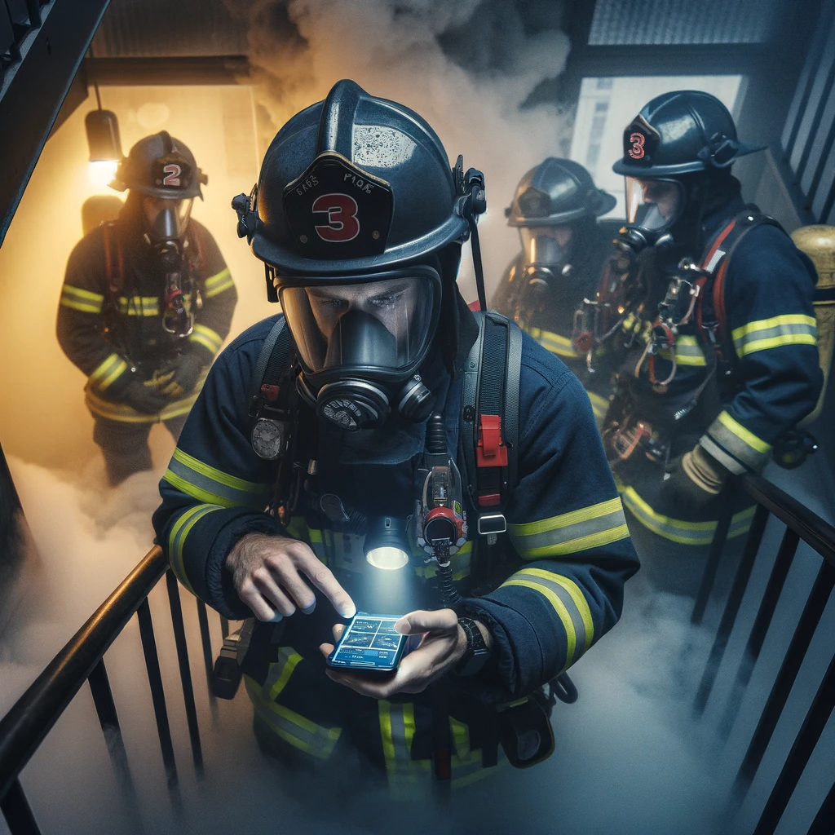
Solution
We propose an application that should enhance the saving operation of the disabled people from a building that is in an emergency condition.

Slide 5
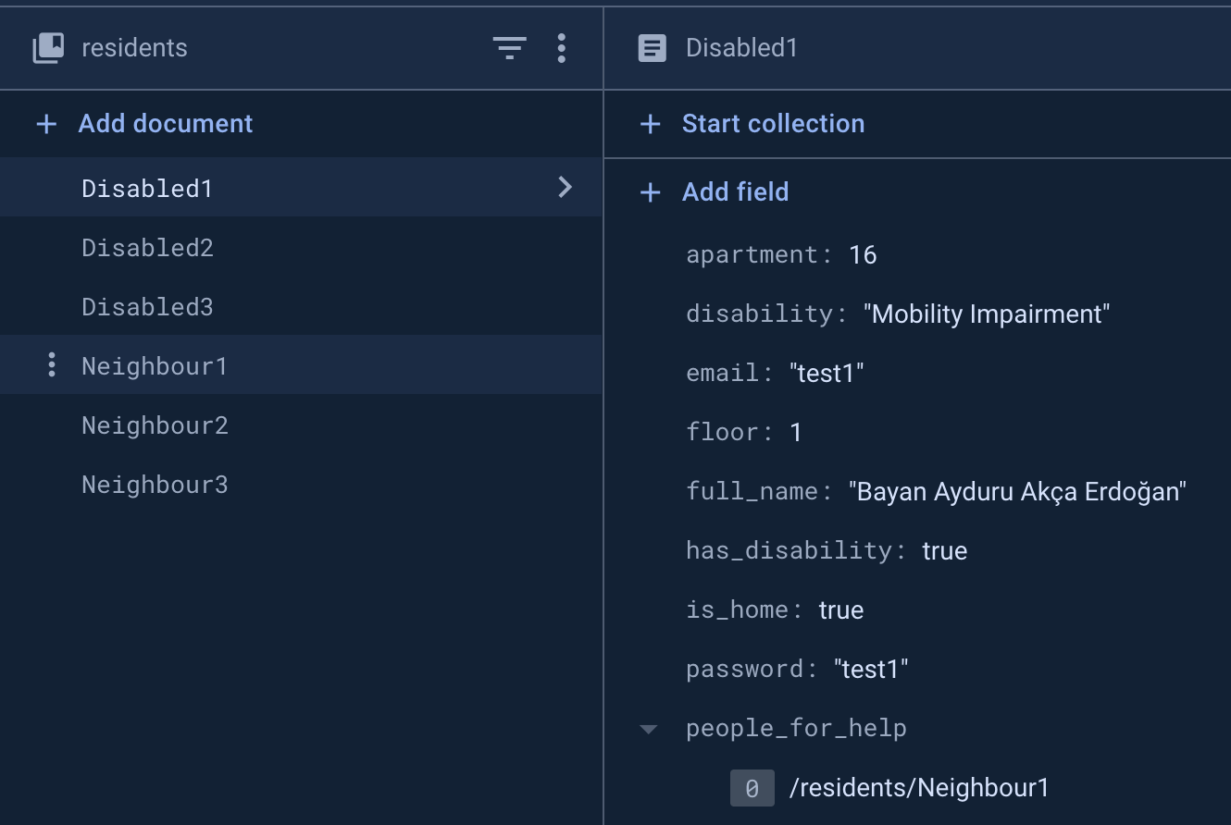

Overview
This application should be utilized by the building’s management in order to have the control over its residents’ data and the evacuation order if a disaster were to occur.

Slide 6
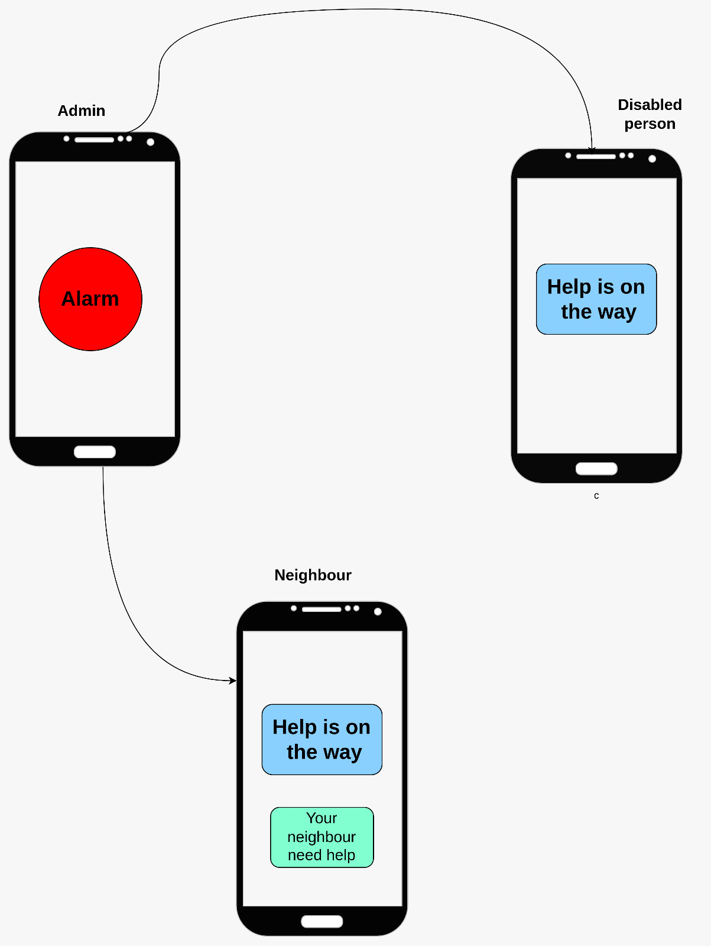
Administrator
The building administrator needs to press the evacuation button, so that all the other residents would be notified

Slide 7
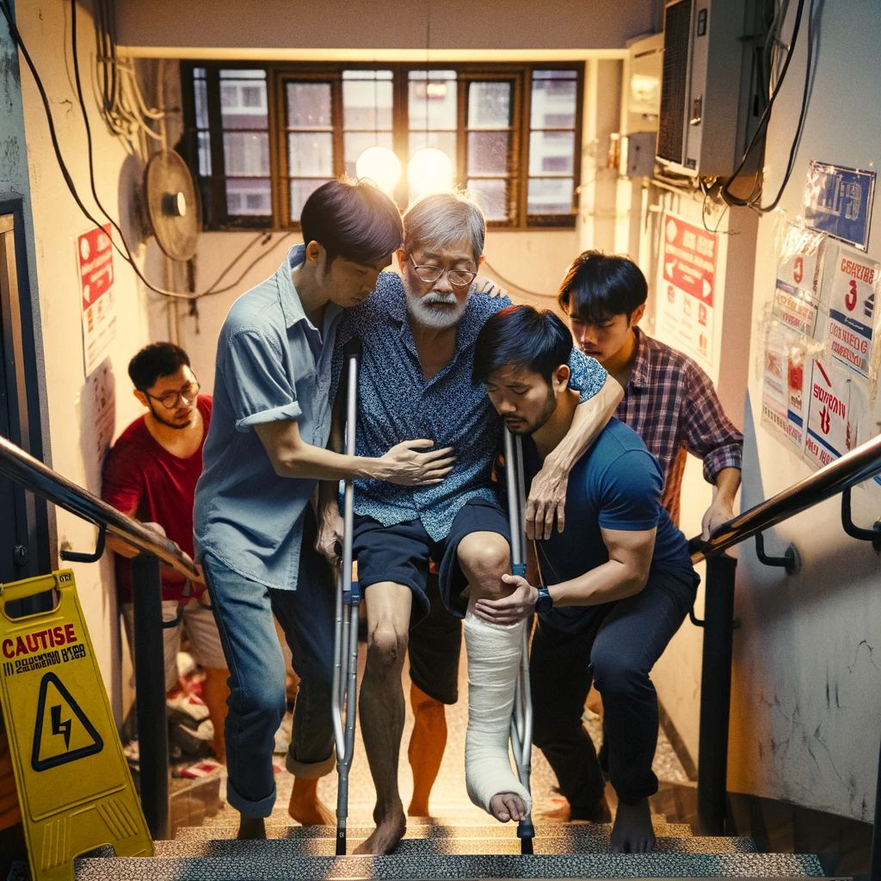
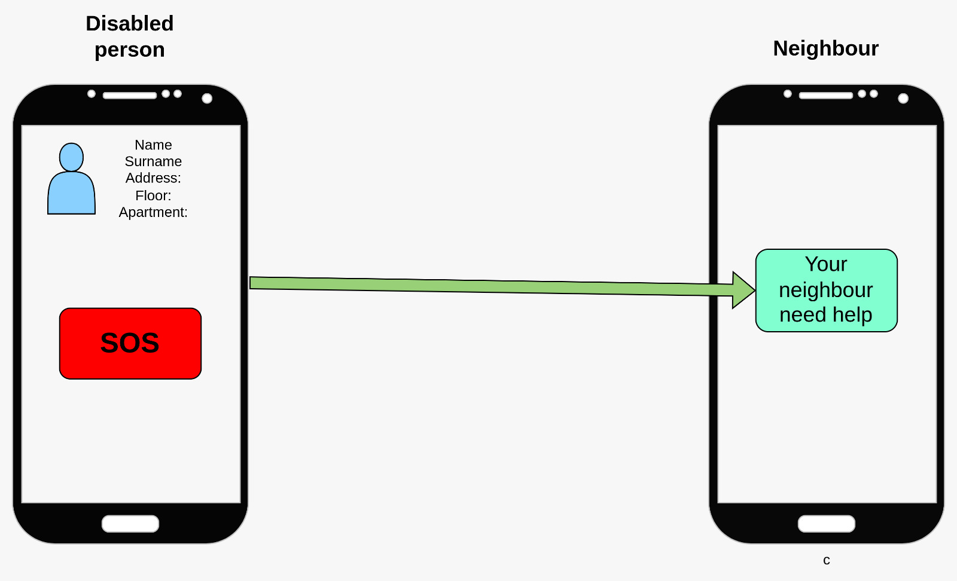
Resident
In the case of an emergency, the person with disabilities should be able to notify his close neighbours

Slide 8
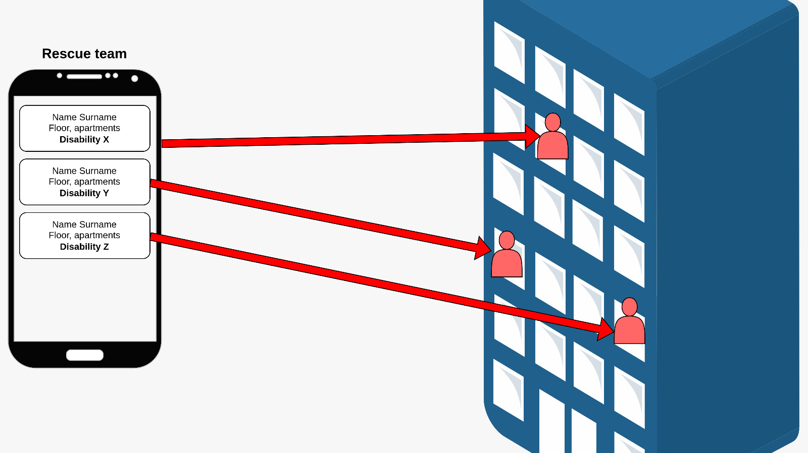
Rescue team
The rescue team needs to have a list of all the disabled people as a priority queue, so that it knows who needs aid right away

Slide 9
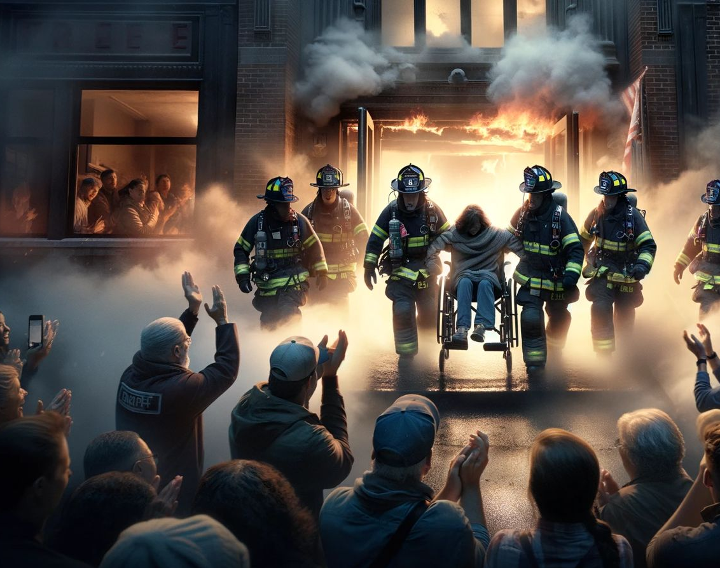
Conclusion
Enhance the logistics for the rescue team
Strengthen the relationship between the neighbors and a person with disabilities
Add an additional layer of security for the building

